Slide 1
Pokerbots 2023
Lecture 1: Introduction to Pokerbots
Notes:
Welcome!

Slide 2
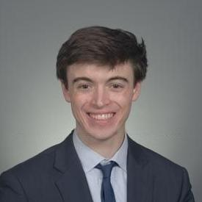
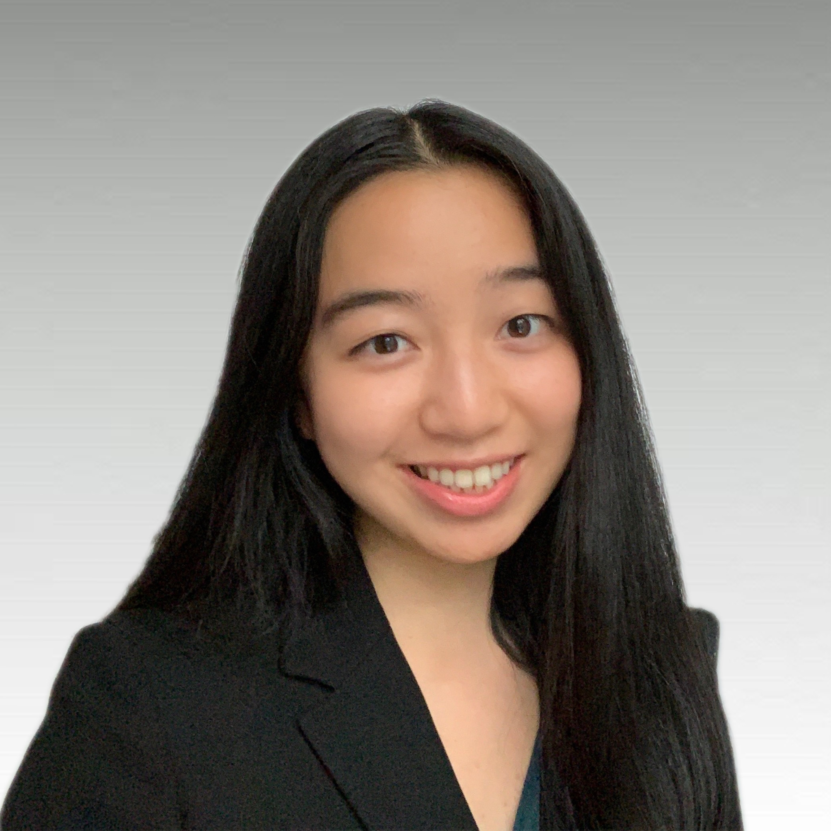
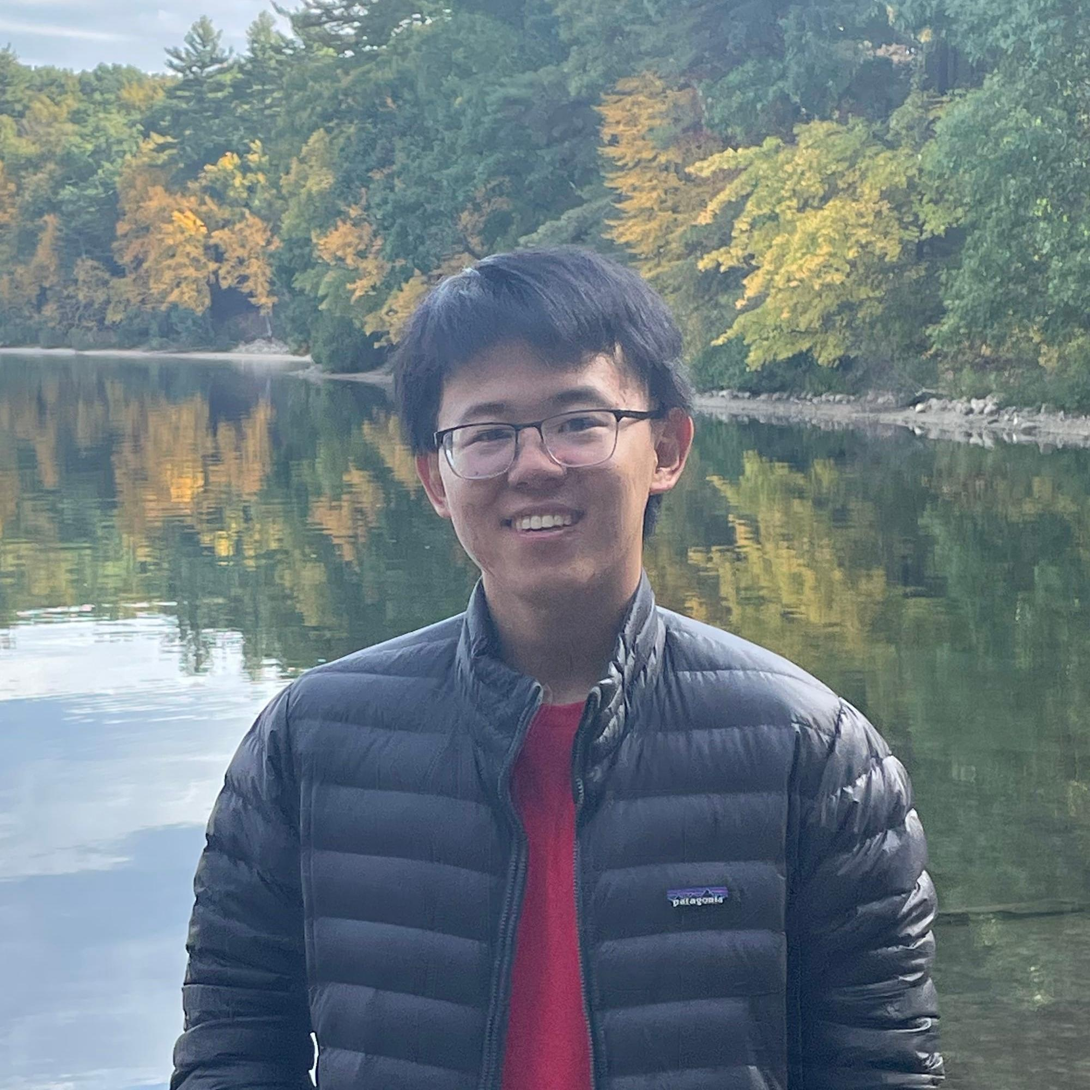
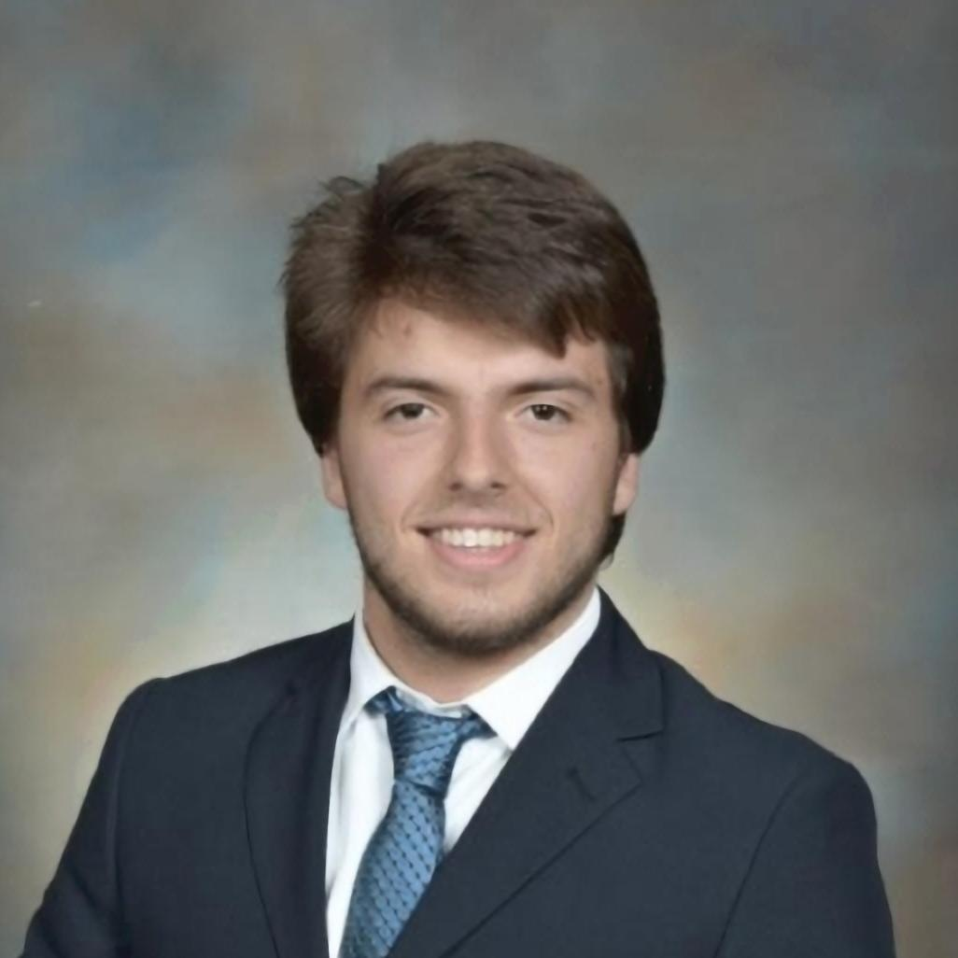
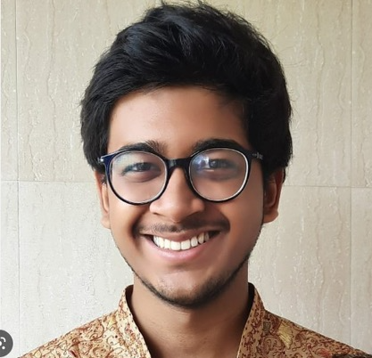
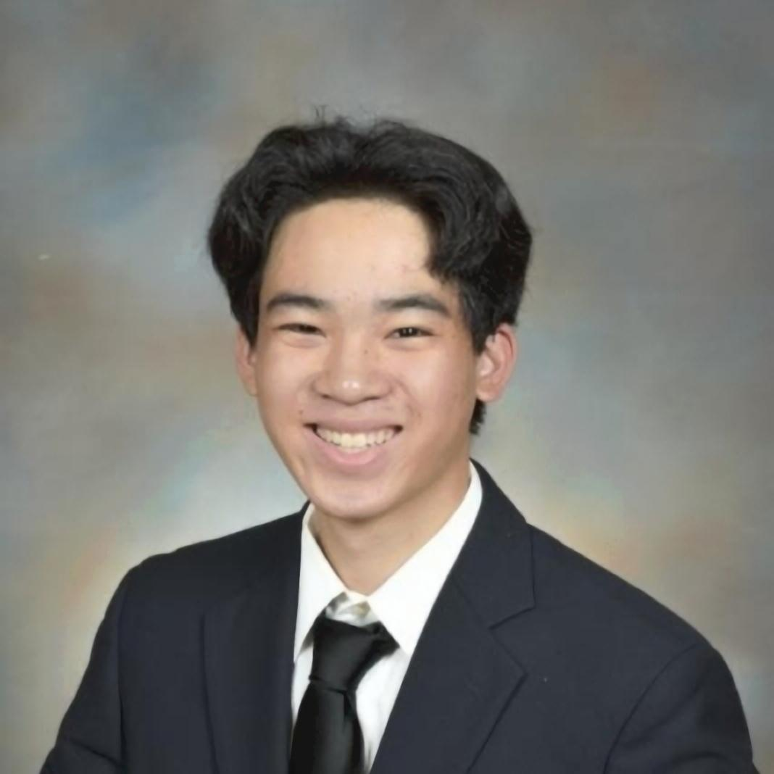
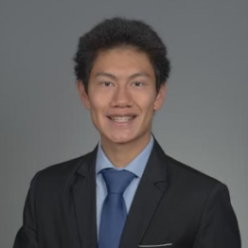
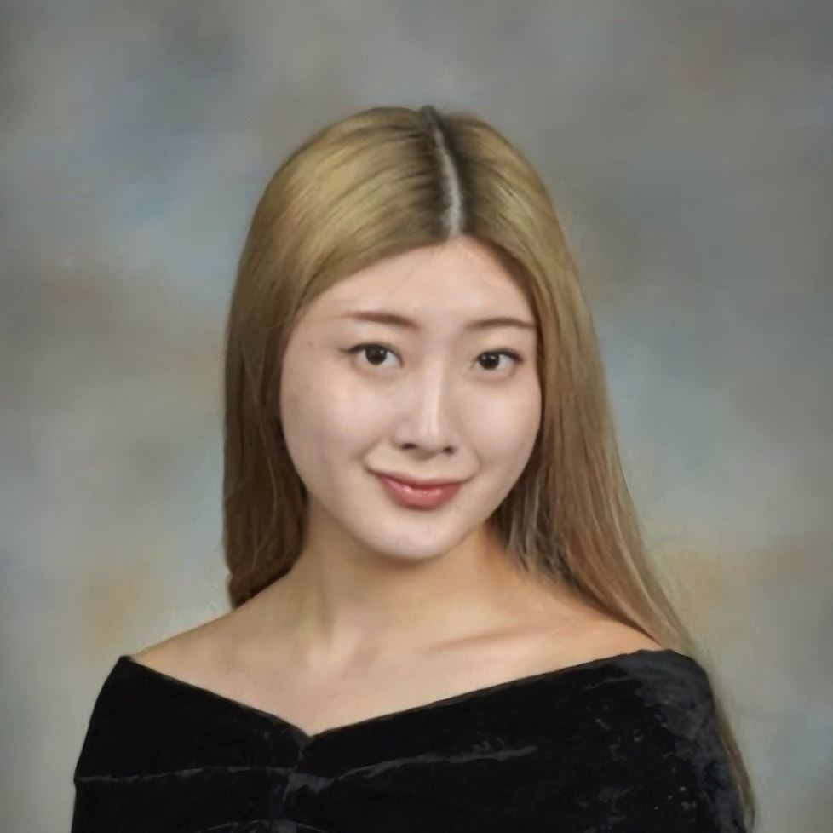
Meet the team
Notes:
This is our amazing team!

Slide 3













Sponsors
Notes:
Shreyas
---

Slide 4
Resume Drop:
pkr.bot/drop

Slide 5
Giveaways

Slide 6
Giveaway Game:
pkr.bot/height
Notes:
Guess the average height of the PKR team
Sony Headphones

Slide 7
Raffle:
pkr.bot/hello
Notes:
Airpods!!!

Slide 8
Agenda
Class overview + logistical details
Intro to poker + variant rules
Skeleton bot setup and connecting to the scrimmage server
Testing your bot locally
Overview of skeleton bot architecture
Coding Lecture 1 reference bot

Slide 9
Class Overview + Logistical Details

Slide 10
Class Structure
Six lectures, MWF 10 to 11:30pm EST (in 6-120 or pkr.bot/class for Zoom)
Office hours, MWF 11:30 to 1pm EST (in 6-120 or pkr.bot/oh for Zoom). TR 12 to 1pm EST (virtual at pkr.bot/oh)
Scrimmage server (first three weeks)
Weekly tournaments
Final tournament and event (Feb 3rd)

Slide 11
Team Formation
Piazza
Team formation post to come after lecture
Poker Afternoon #1
1/11 3:00-5:00pm EST
Location: 2-131
Come try out the 2023 poker variant in action!
Poker Afternoon #2
1/18 3:00-5:00pm EST
Location: TBD
Team Specific Prizes under Miscellaneous Prizes category

Slide 12
>$40k
Total Prize Amount

Slide 13
Prizes
Grand prize: $7.5k
2nd - 5th place : $5k, $3.5k, $2k, $1k
Bot Language Specific Prizes
~$2.5k/week Scrimmage Server Prizes
All announced prized can be viewed on the syllabus
More prizes to be announced soon!
Notes:
The other prizes will be announced later; some prizes will not be announced until after they have been awarded.
4th and 5th
Language bots - set a minimum of where they're placing
Scrimmage server prizes
Longest time at top of scrimmage server
Top 3 on scrimmage

Slide 14
6 Lecture Titles
Introduction to Pokerbots
Poker Theory
Game Theory
Guest Lecture: Noam Brown
Engineering and Performance
Advanced Topics
Notes:
Talk about target audiences for the six classes (more beginner for the first one, second one is beginner if you know poker. Will have live coding in classes 1+2. All slides will be released and all lectures will be recorded and made available on the pokerbots website) Also talk about class objectives briefly for each one.

Slide 15
How to Receive Credit For This Course
Participate
Improve
Report
Submit a bot to the scrimmage server every week
Each week you should beat your bot from the previous week
Submit a 3-5 page strategy report at the end of the competition
Notes:
Strategy report 3-5 pages; miss a week -> submit a make up, 0.5 pages double spaced, simple explantion of what you tried to do that didn’t work

Slide 16
Intro to Poker + Variant Rules

Slide 17
Heads-up No-limit Hold’em Poker Rules
Objective: earn as many chips as possible
Players receive two secret cards (hole cards)
Players bet into a pot in several rounds; the pot is given to the player with the best poker hand
Structure of a betting round: first player can bet 0 (check) or any amount between “big blind” and the # of chips they have remaining. If they check, action passes to second player. If they bet, second player can fold, call, or raise
Hand strength is determined as the best 5-card poker hand you can form out of 7 cards: 2 hole cards and 5 community cards
Notes:
one of the most famous card games in the world

Slide 18
Poker Rules
Two cards dealt to each player (hole cards)
Betting round (first betting round begins with blinds)
Flop (3 community cards revealed)
Betting round
Turn (+1 community cards revealed [4 total])
Betting round
River (+1 community cards revealed [5 total])
Betting round
Settlement (showdown)

Slide 19
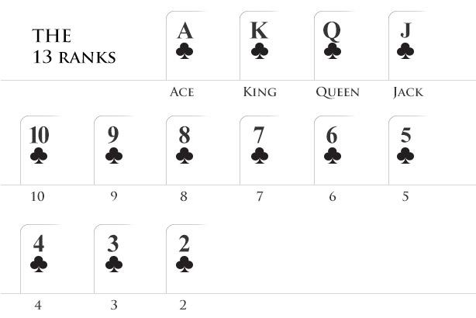

Card Rankings
Notes:
https://www.wsop.com/poker-hands/

Slide 20
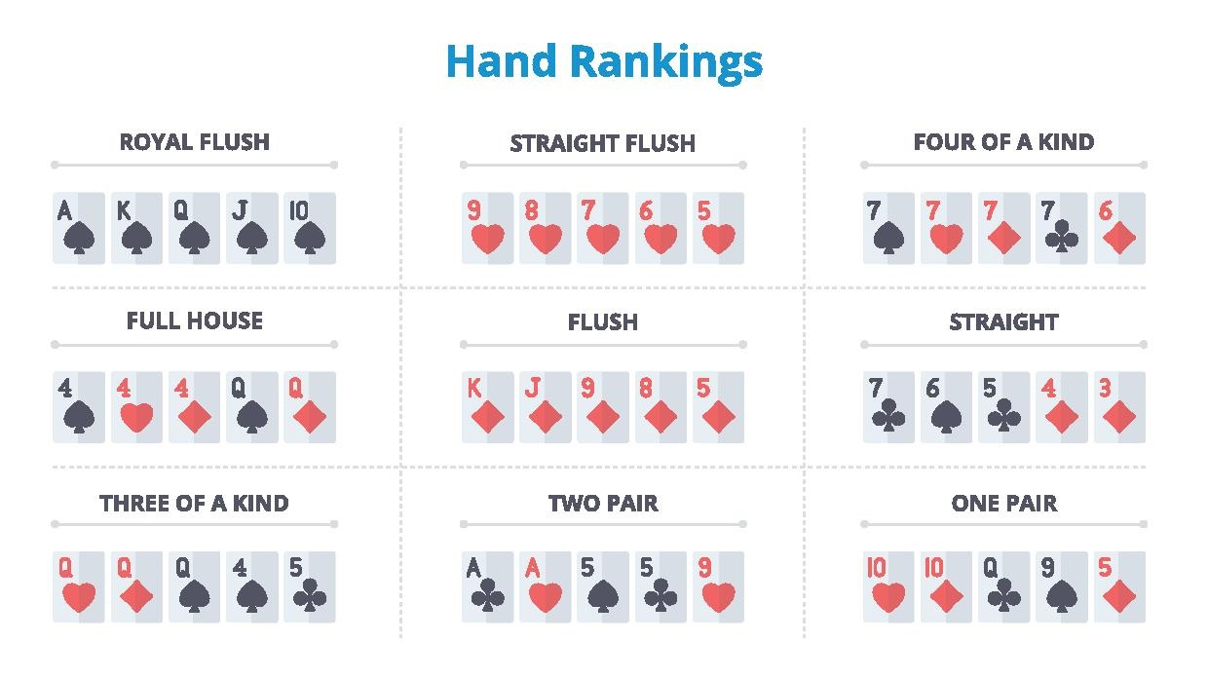
Poker Hand Strength

Slide 21
2023 Variant Reveal

Slide 22
2023 Variant - River of Blood Hold’em
Another card will be shown and another round of betting will occur if a red card or non-club or non-spade is shown
Occurs only in situations after the river or on the Run
Run refers to the cards that are dealt after the river in the non-spade & non-club situations
GOAL: If you get to the river and a red card is revealed, navigate how to still make good decisions and maximize your bankroll

Slide 23

River of Blood Hold’em (Visualized)
Run
Flop
Turn
Showdown

Slide 24
Skeleton Bot Setup: Connecting to the Scrimmage Server

Slide 25
Before You Code
See Piazza post @10 to set up your development environment for Pokerbots
Once finished, make a GitHub account to facilitate code management
Read up on using Git from the command line

Slide 26
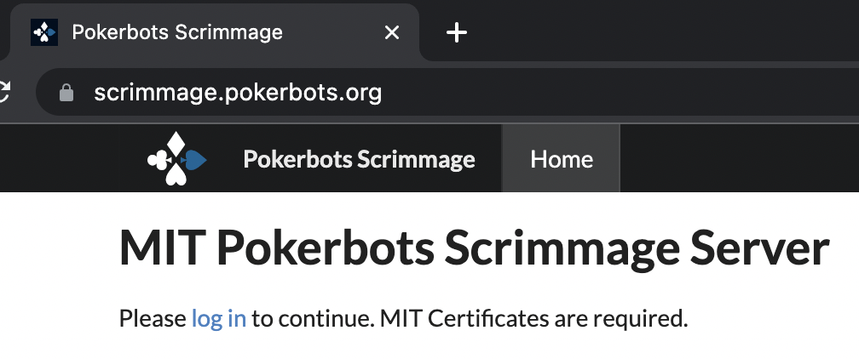
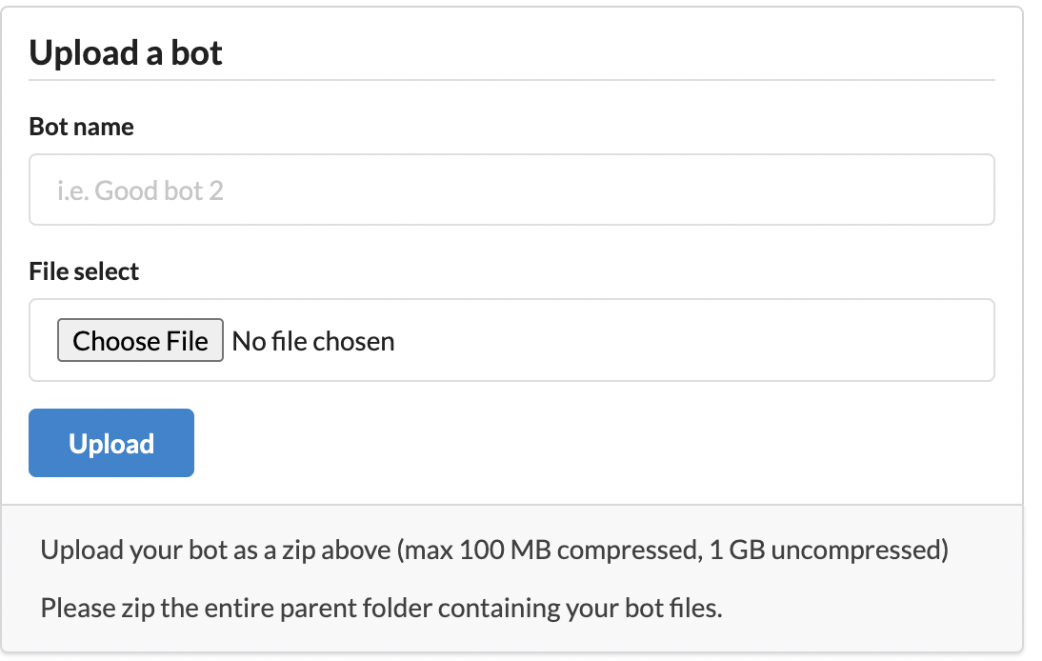
Getting Set Up
Clone engine from mitpokerbots/engine-2023; create new repository for your code
Scrimmage server: download ZIP file from GitHub website and upload it directly.

Slide 27
Testing Your Bot Locally

Slide 28
Engine Config Parameters
Pull the engine from github.com repository mitpokerbots/engine-2023
config.py parameters: number of hands, number of seconds, where to bots

Slide 29
Overview of Skeleton Bot Architecture

Slide 30
Skeleton Bot Structure
Engine info
GameState, RoundState, and BoardState classes
Bot walkthrough

Slide 31
Coding reference-lecture-1 bot

Slide 32
Example Bot
We want to place our strongest cards strategically
We want to raise the stakes if we are holding good cards
Eventual goal: use a more advanced method to choose our hole cards combined with more sophisticated betting logic

Slide 33
Giveaway Winners

Slide 34
Average Height Game:
68.625 inches
Notes:
Guess the average height of the PKR team
Sony Headphones

